Slide 1
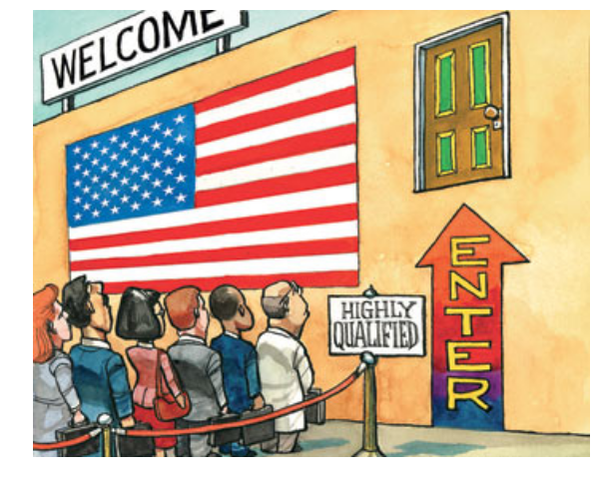
H1B Visa Analysis
Team2
Jared Liu & Cyndi Wang

Slide 2
Problem
H1B visa – most common visa for international students if they want to hold full time jobs after graduation.
1. Predict whether or not an H1B application will be approved or denied
2. Which factors are more important in this process? ( Salary? Occupation? )

Slide 3
Business Value
Uncover insights to help employers and international students better understand this process.
Employers can:
Make better strategy, and
Avoid wasting money and efforts
Students can:
Make better study plan
Choose a more suitable employer
Better chance to stay in the US

Slide 4
Key Insights
An application’s truthfulness, completeness, and detailedness is the most influencing factor
Employers have to compensate foreign workers fairly
H1B visa demands highly-skilled applicants

Slide 5
Data Cleaning and Feature Engineering
WAGE_DIFF: WAGE_HOURLY - PW_WAGE_HOURLY
EMPLOY_PERIOD: PERIOD_OF_EMPLOYMENT_END_DATE -PERIOD_OF_EMPLOYMENT_START_DATE
CASE_PROCESSING_TIME: DECISION_DATE - CASE_SUBMITTED
INDUSTRY: based on NAICS_CODE (first two numbers)
OCCUPATION: based on SOC_CODE (first two numbers)

Slide 6
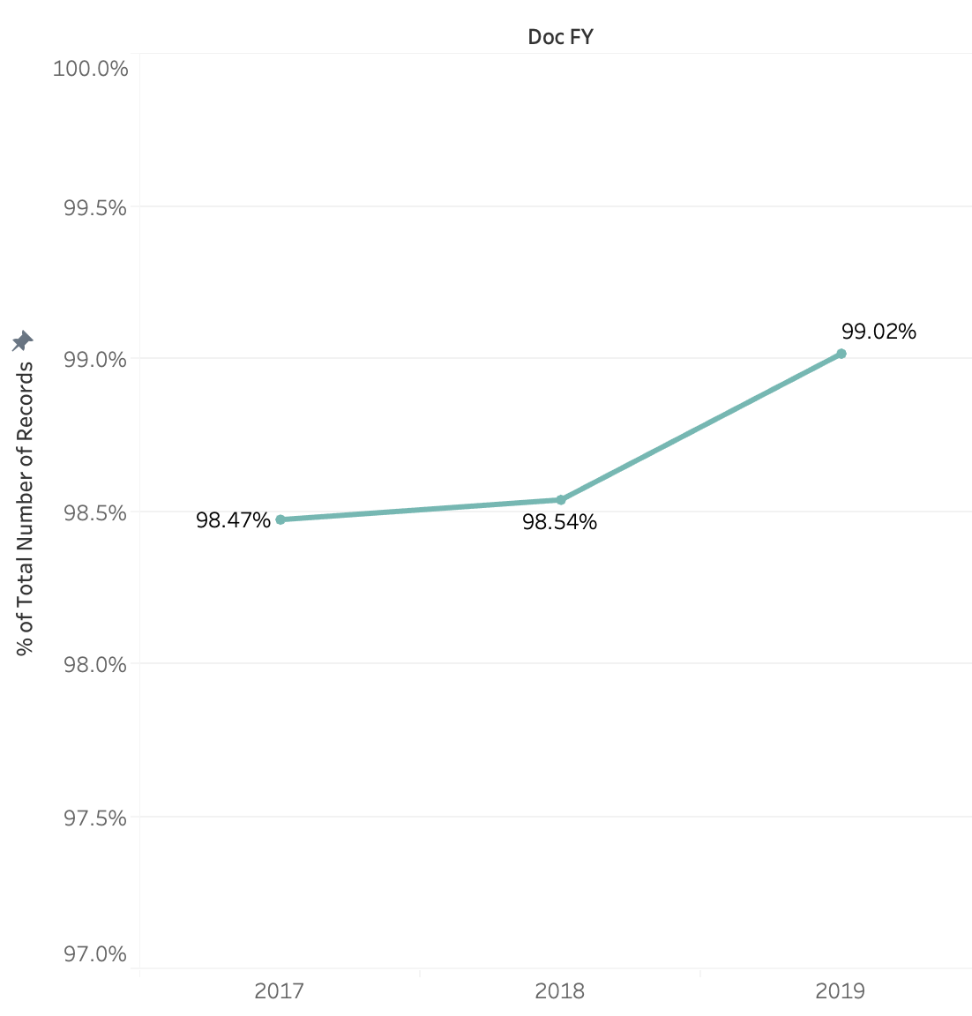
Certified rate keeps increasing in recent years.
Data Visualization

Slide 7
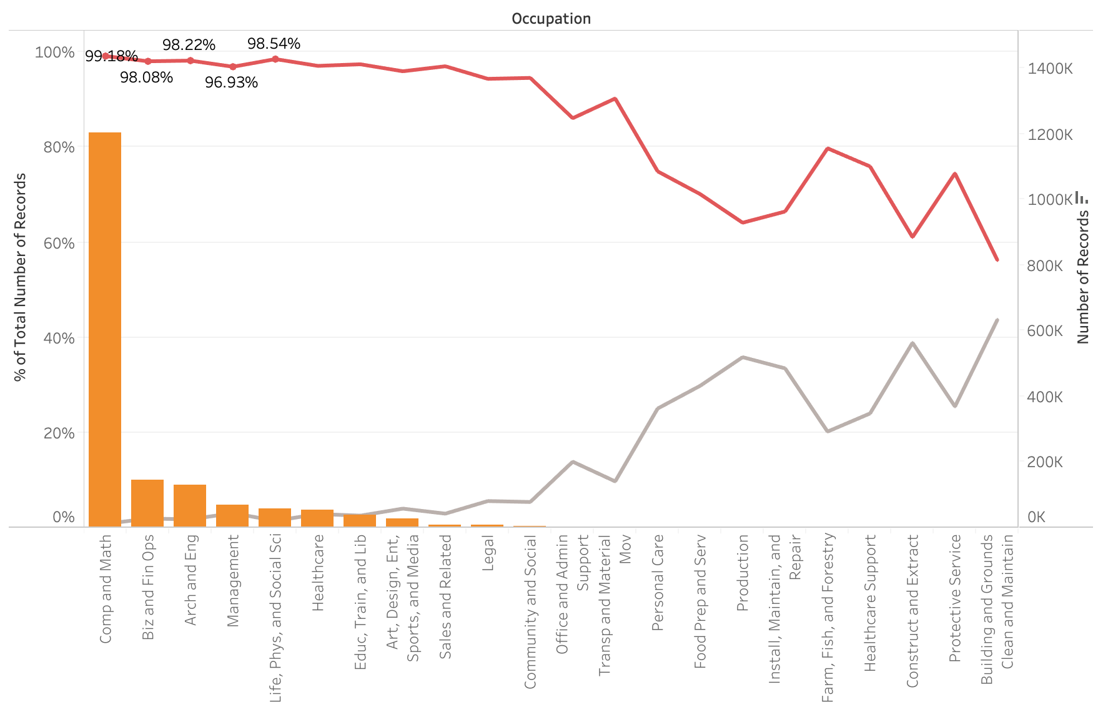
Certified rate varies drastically among occupations, with computer, business and engineering related positions at the top. More popular occupations – more opportunities for international students

Slide 8
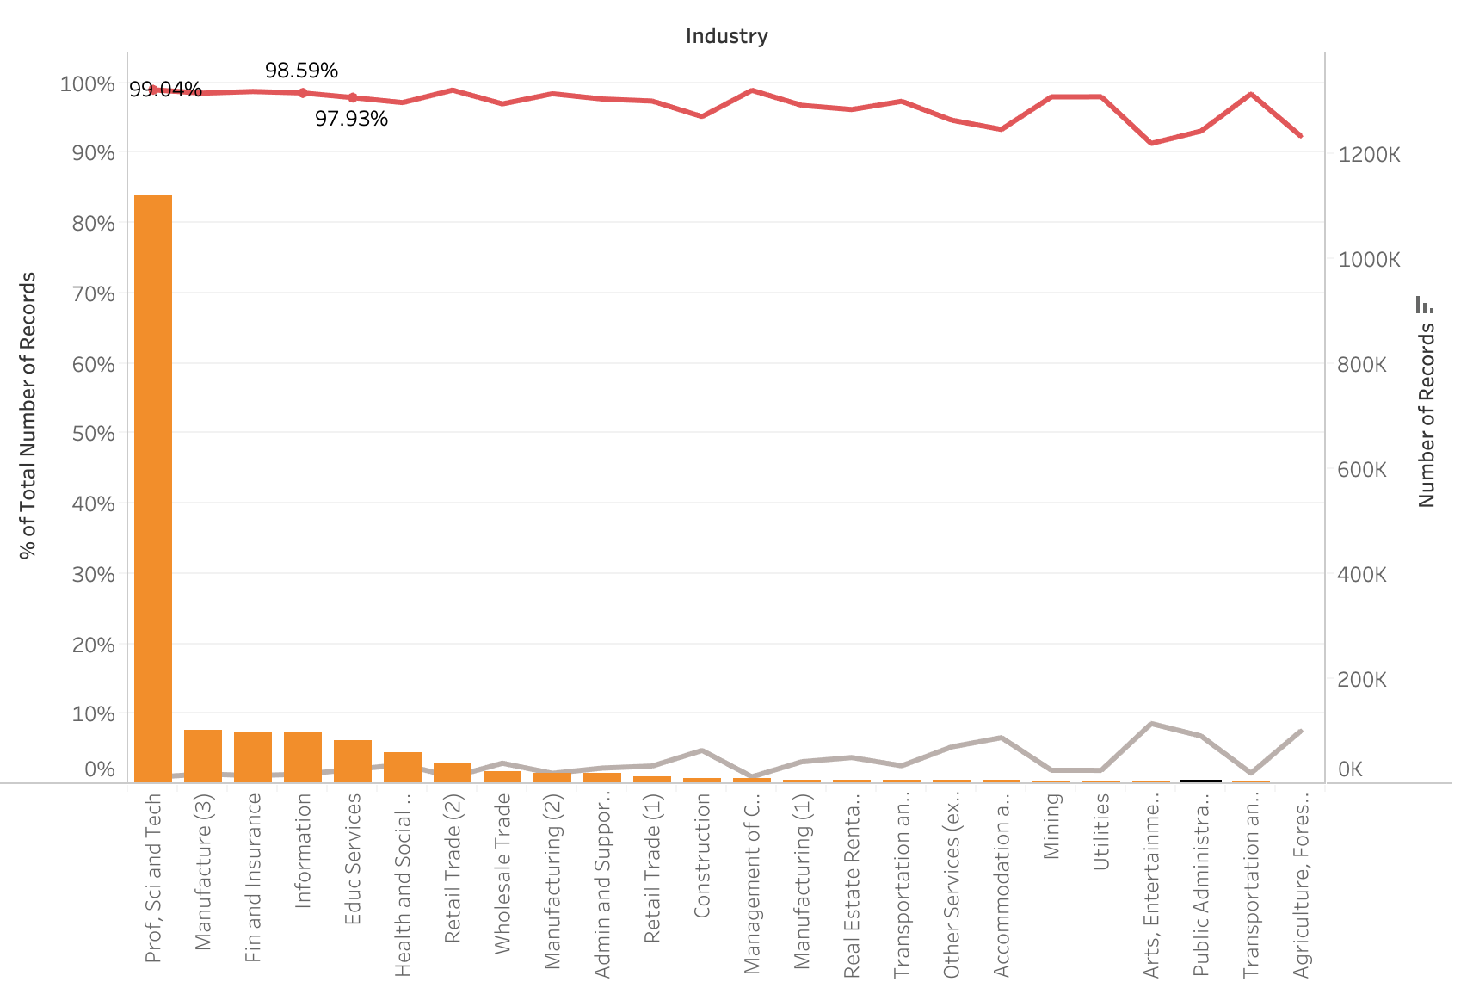
Certified rate does not vary much among industries.

Slide 9
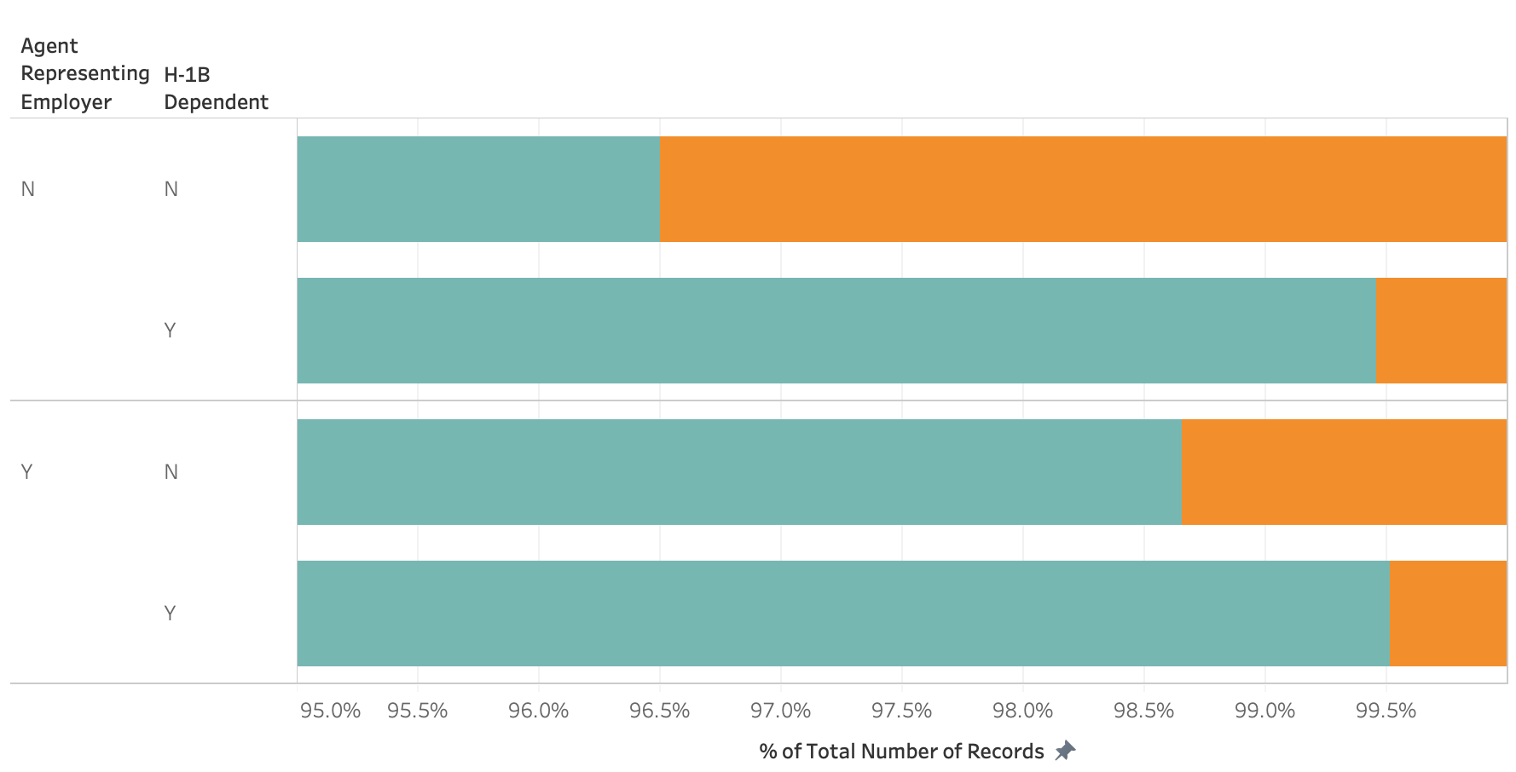
Companies that are H-1B dependent and with attorneys have advantages.

Slide 10
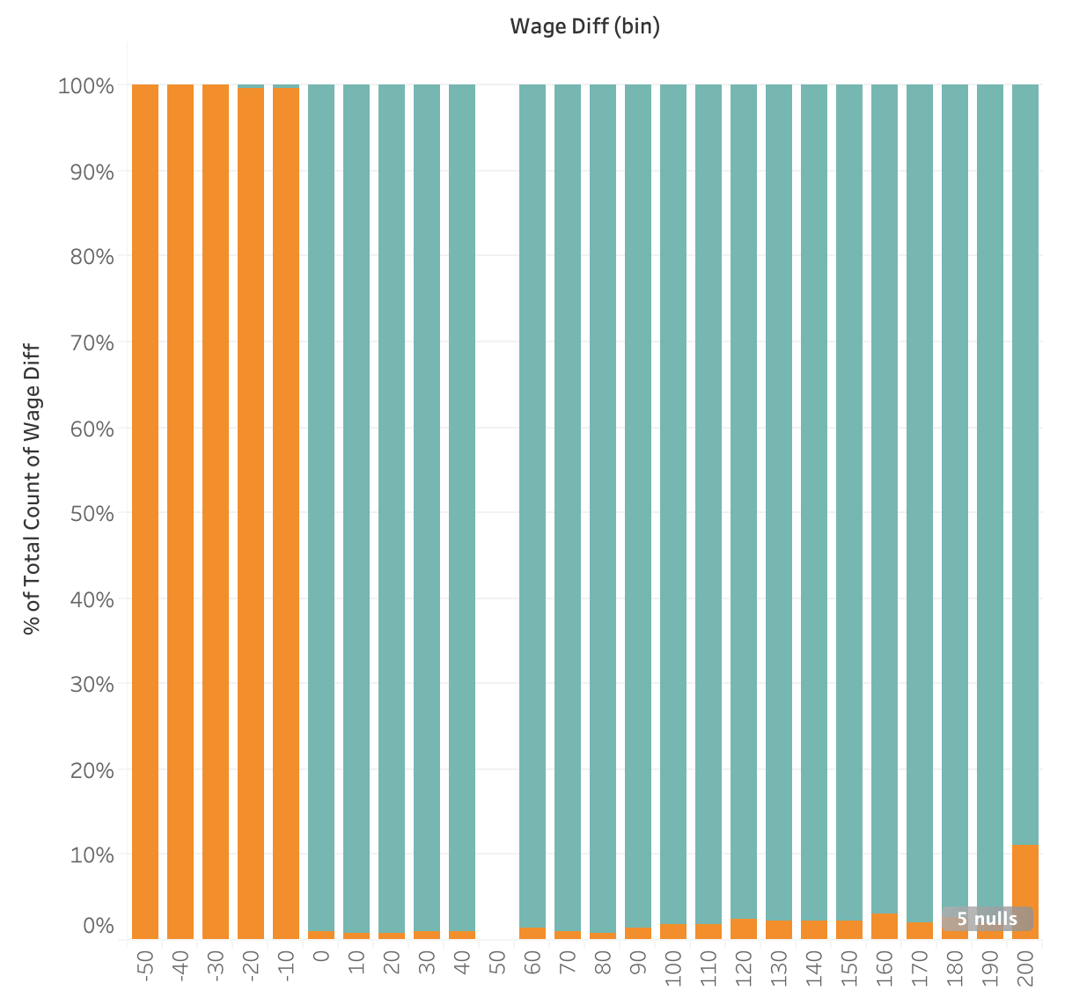
If applicant’s wage is lower than prevailing wage, the chance to be denied is much higher.

Slide 11
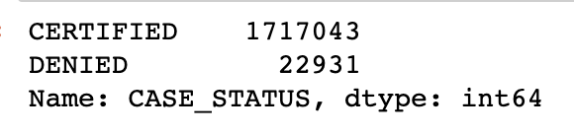
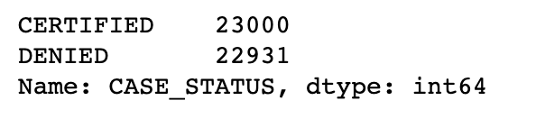
Modeling
Challenge: 50+ columns initially
Solution: handpick 20+ columns first, and keep only 9 variables in our final model
Challenge: imbalanced data
Solution: Undersampling. Keep all denied cases, and randomly select equal sized certified cases

Slide 12
Model Selection - Classification
Model | Accuracy | Precision | Recall | F1-score | ROC AUC
Logistic Regression | 0.795 | 0.815 | 0.762 | 0.788 | 0.795
Decision Tree | 0.868 | 0.912 | 0.814 | 0.860 | 0.868
Random Forest | 0.938 | 0.976 | 0.897 | 0.935 | 0.938
XGBoost | 0.891 | 0.942 | 0.833 | 0.884 | 0.891

Slide 13
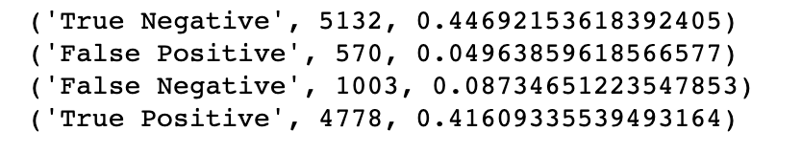
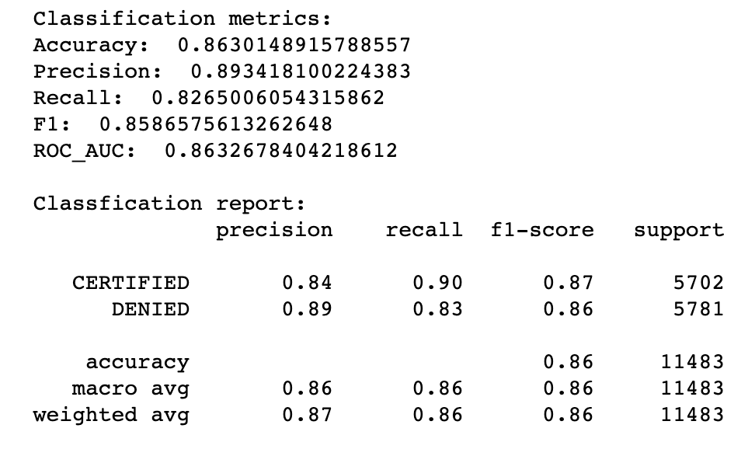
Performance Metrics
Confusion Matrix
Low False Negative: 8.7%
(wrongly classify denied cases as certified)
Classification Report
All metrics scores are greater than 80%
Specifically, recall for denied cases: 83%

Slide 14
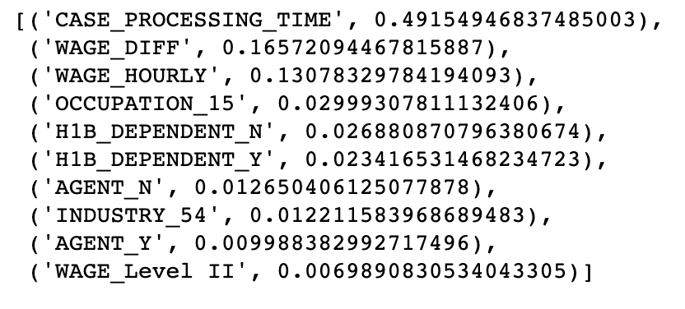
Feature Importance
Higher than average salary
Tech-related positions and industries
Experienced employer
OCCUPATION_15: Computer and Mathematical Occupations
INDUSTRY_54: Professional, Scientific, and Technical Services

Slide 15
Case Processing Time Implication
Case processing time cannot be used directly in production.
What it implies is that if a case is undergoing RFE (request for evidence), it is much more likely to be denied.
What matters most is the supporting written document part, not the objective values, which cannot be seen directly from the dataset.

Slide 16
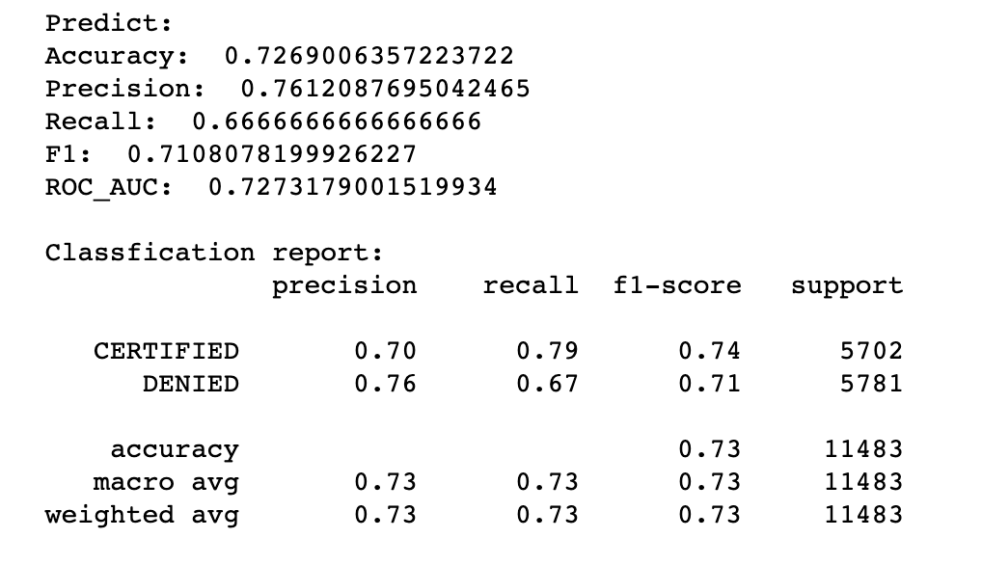
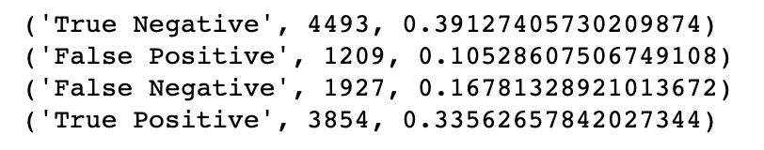
Model Without Case Processing Time
Model performance gets hurt a lot after removing case processing time as expected.

Slide 17
Conclusion
An employer should carefully prepare H1B application materials to demonstrate that the foreign worker can meet the job requirements that the employer was not able to find from a US-based worker. These materials should be as detailed as possible to avoid REF
The wages an employer pays for its foreign workers have to be above the prevailing wage
Employees work for specific industries are more likely to get approved (Universities, tech, finance, and Insurances)
Foreigners should seek job positions require high skills (computer, math, science, management)

